Slide 1
ORGANISATIONAL
BEHAVIOUR
CHAPTER-14
POWER AND POLITICAL BEHAVIOUR

Slide 2
LEARNING OBJECTIVES
Power and politics are common in organisations.
Power refers to the ability to influence people and events.
Power assumes atleast ten different dimensions.
Power generates from different sources.
If power refers to the ability to influence others, politics relates to the ways people gain and use power in organisations.
Politics is characterised by disagreement, diversity, scarcity and interest.
There are atleast seven types of political activity – attacking and blaming others, forming coalitions, managing impressions – are some of them.
Organisational politics has both functional and dysfunctional consequences.
Politics has ethical dimension too.

Slide 3
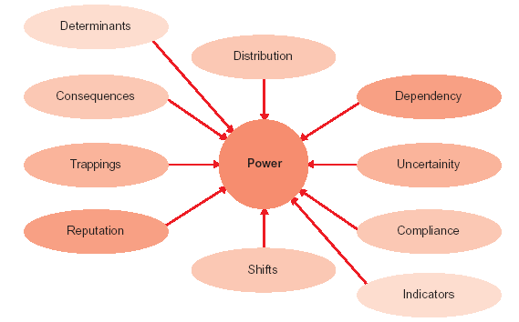
Power Dynamics

Slide 4
Symbols of organisational power
Executives can use power and political skills in many different, concrete and symbolic ways. Acquiring status symbols (e.g., size of the office, number of telephones, perks, etc.,) is one of the most common ways in which an executive’s power in the organisation gets manifested. Effective and really powerful executives, however, tend to use power in a manner which contributes to their effectiveness. Some of the indicators of effective utilisation of one’s power are :
• The executive has easy access to crucial organisational information about major decisions
and changes.
• The executive can favourably intercede on behalf of someone who is in trouble with the authorities.
• The executive can get a desirable placement, promotion or above-average salary for subordinate(s).
• The executives can get approval for expenditure which is beyond the budget.
• The executive can influence the agenda for meetings.
• The executive has fast, easy and regular access to top decision-makers.

Slide 5
Indicators of Power
Indicator Examples
  1. Determinants of power The capacity to use any of the bases of power : reward power, coercive power, referent power, legitimate power, or expert power.
  2. Consequences of power Budget allocations, win-loss record in debated issues, ability to authorize exceptions to policy, authority to hire and fire others.
  3. Symbols Size, location and furnishings of one’s office. Invitations to attend social events and seating at those events.
  4. Reputation Comments by others acknowledging one’s power. Seeking one’s advice. Asking for one’s opinion.
5. Representation on committees The number and status of committee memberships; boards of directors, advisory councils, presidential task forces and executive committees.

Slide 6
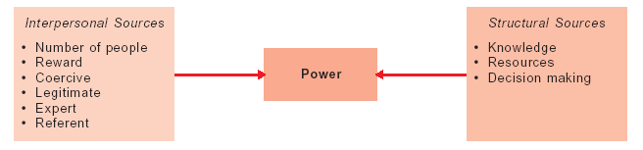
Source of Power in Organisations
Power Tactics
Individual and Intra-group Intergroup
• Assertiveness • Uncertainty absorption
• Friendliness or ingratiation • Substitutability
• Rationality • Integrative
• Sanctions • Importance
• Higher authority
• Bargaining
• Coalition

Slide 7
Use of Power Tactics
When managers When managers
influenced superiors influenced subordinates
Most popular Reason Reason
Coalition Assertiveness
Friendliness Friendliness
Bargaining Coalition
Assertiveness Bargaining
Higher authority Higher authority
Least Popular Sanctions

Slide 8
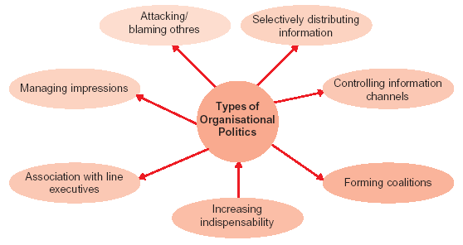
OB Challenges

Slide 9
Political Strategies for Attaining Power of Organisations
Talking counsel
Maintaining maneourability
Promoting limited communication
Creating a sponsor – protégé relationship
Stimulating competition among ambitious subordinates
Neutralising potential opposition
Making strategic replacements
Committing the uncommitted
Building personal stature
Employing trade-offs
Using research data to support one’s own point of view
Restricting communication about real intentions
Withdrawing from petty disputes

Slide 10
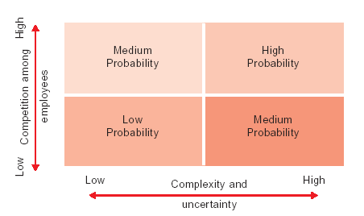
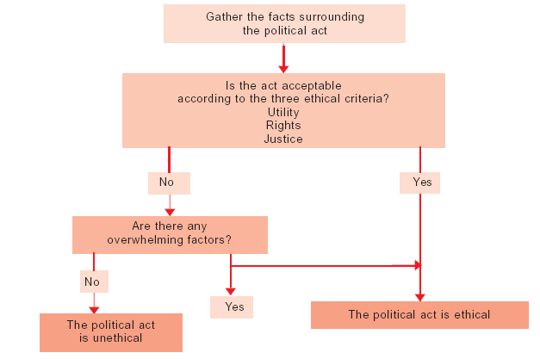
Probability of Political
Behaviour in Organisations
Judging a Political
act as
Ethical or Unethical

Slide 11
Summary
        Power is the ability to influence people and events. Distribution, dependency, uncertainty, compliance, indicators, determinants, consequences, symbols, reputation and shifts constitute power dynamics.
        Power generates from two broad sources: interpersonal and structural. Interpersonal sources include rewards, coercion, legitimate, expert and referent. Structural sources include knowledge, resources and decision making.
        Managers need to use power effectively. If used negatively, power is capable of destroying individuals and organisations.
        Closely related to power is politics. Politics relates to the ways people gain and use power in organisations. Individuals, departments and coalitions in an organisation engage in political activity to enhance their power.
        Attacking or blaming others, selectively distributing information, controlling information channels, forming coalitions, increasing indispensability, associating with line executives and managing impressions are the major organisational political activities.
        Organisational politics have functional as well as dysfunctional consequences. Good or bad, political activities in organisations are inevitable and managers should manage them carefully.

Slide 12
Key Terms
Power and Politics l
Political tactics
Kautilyanism
Impression management
Machivallianism
Power dynamics
Power tactics
Ethical dilemmas

